Slide 1
Restaurant Rating Prediction using Machine Learning Algorithms

Slide 2
Problem Statement:
The main goal of this project is to perform extensive Exploratory Data Analysis(EDA) on the Zomato Dataset and build an appropriate Machine Learning Model that will help various Zomato Restaurants to predict their respective Ratings based on certain features.

Slide 3
Objective:
Design a machine learning model to predict the rating of the restaurants which accepts the order from Zomato. The model will help various Zomato Restaurants to predict their respective Ratings based on certain features.
Benefits:
Predicting new restaurant ratings.
Helps new restaurants in deciding their theme, menus, cuisine, cost etc for a particular location.
Positive customer ratings increase revenue.
Gives better insights on restaurants which customer likes.

Slide 4
LITERATURE REVIEW:
Read discussion forums which described the problem statement more in detail.
Found out multiple approaches that could be used to solve this challenge.
Helped us realize in advance that our dataset needs a lot of pre-processing.

Slide 5
DATASET:
url : This feature contains the url of the restaurant on the Zomato website
address : This feature contains the address of the restaurant in Bangalore
name : This feature contains the name of the restaurant
online_order : whether online ordering is available in the restaurant or not
book_table : table book option available or not
rate : contains the overall rating of the restaurant out of 5
votes : contains total number of upvotes for the restaurant
phone : contains the phone number of the restaurant
location : contains the neighborhood in which the restaurant is located
rest_type : restaurant type
dish_liked : dishes people liked in the restaurant
cuisines : food styles, separated by comma
approx_cost(for two people) : contains the approximate cost of meal for two people
reviews_list : list of tuples containing reviews for the restaurant, each tuple consists of
two values, rating and review by the customer
menu_item : contains list of menus available in the restaurant
listed_in(type) : type of meal
listed_in(city) : contains the neighborhood in which the restaurant is located.

Slide 6
DATA PRE-PROCESSING:
The Dataset contained 17 Attributes.
Records with null values from ratings column were replaced by the mean of the rate column.
Values in the ‘Rating’ column were changed. The ‘/5’ string was deleted. For eg. If the rating of a restaurant was 3.5/5, it was changed to 3.5.
Renamed some of the column names.
Records with null values were dropped from other columns.
Using Label Encoding from sklearn library, encoding was done on columns like book_table, online_order, rest_type, location, cuisines.
Using Standard scaling from sklearn library, scaling was done on all the columns except rate column.

Slide 7
EXPLORATORY DATA ANALYSIS:
A lot of effort went into the EDA as it gives us a detailed knowledge of our data.
Exploratory Data Analysis (EDA) is an approach/philosophy for data analysis that employs a variety of techniques (mostly graphical) to
maximize insight into a data set;
uncover underlying structure;
extract important variables;
detect outliers and anomalies;
test underlying assumptions;
develop parsimonious models.

Slide 8
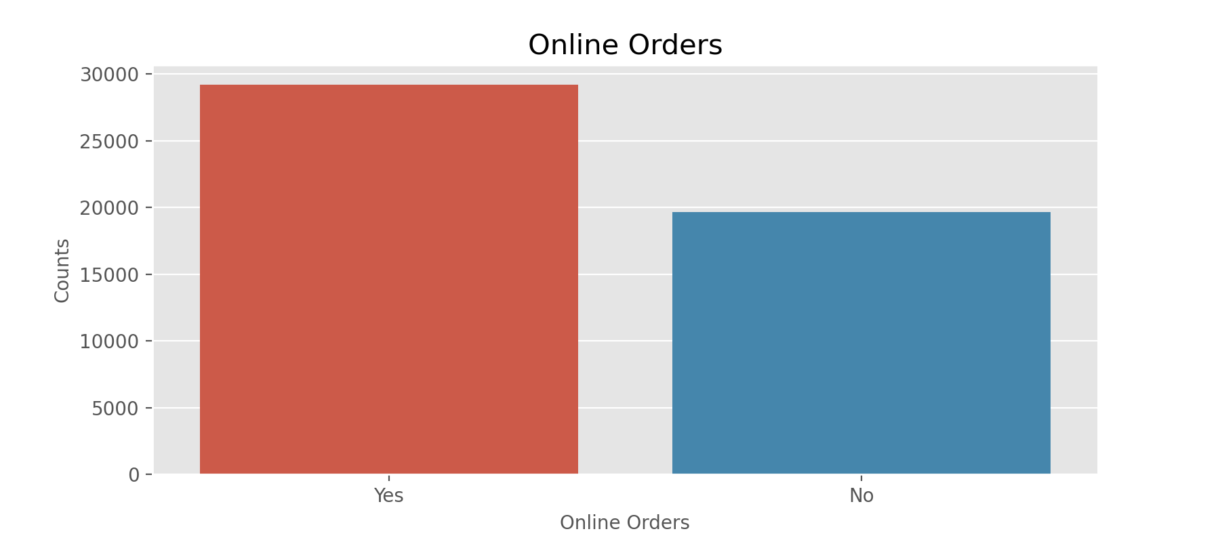
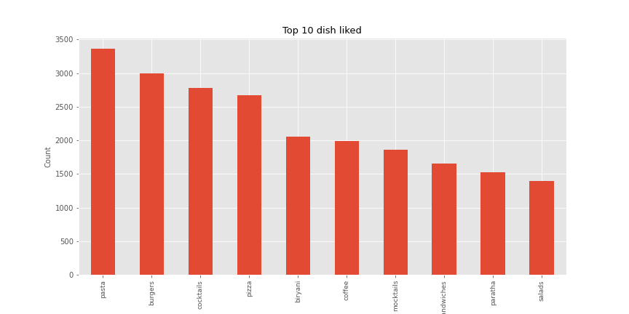
Here, from EDA we can conclude that most of the restaurants have online order facility.
Here, from the dish-liked EDA we can see the top 10 dish-liked in the restaurants.

Slide 9
RANDOMIZATION AND SPLITTING OF DATASET:
The features selected in the preceding step were approved to develop regression models. Initially the dataset was randomized to obtain an arbitrary permutated sample.
It was followed by splitting of the dataset into training (75% of the dataset) and test (25%) sets.
After splitting the data, we train the data using different machine learning algorithms.

Slide 10
LINEAR REGRESSION:
Linear regression is a linear approach for modelling the relationship between a scalar response and one or more explanatory variables. Here, we use multiple regression as we have more than one independent features.
We train the model on the train dataset using linear regression algorithms and check the model score on train and test dataset.
Using r2_score from sklearn library, we predict the accuracy score of the linear regression model.
Accuracy score for Linear regression is 27.20
2. RIDGE REGRESSION:
Ridge regression is a model tuning method that is used to analyse any data that suffers from multicollinearity. This method performs L2 regularization.
We train the model on the train dataset using ridge regression algorithms and check the model score on train and test dataset.
Using r2_score from sklearn library, we predict the accuracy score of the ridge regression model.
Accuracy score for Ridge regression is 27.20

Slide 11
3. RANDOM FOREST REGRESSION:
Random Forest is one of the best useful technique used for multiple decision tree generation. Since our dataset contains lots of attributes to consider for the prediction, we built the model with it.
We train the model on the train dataset using random forest regression algorithms and check the model score on train and test dataset and predict the accuracy.
Accuracy score for Random Forest Regressor: 92.53
4. SUPPORT VECTOR REGRESSION:
Support vector machine (SVM) analysis is a popular machine learning tool for classification and regression.
We train the model on the train dataset using support vector regression algorithms and check the model score on train and test dataset and predict the accuracy.
Accuracy score for Random Forest Regressor: 40.33

Slide 12
RESULTS:
ALGORITHMS | ACCURACY
1. Linear Regression | 27.20
2. Ridge Regression | 27.20
3. Random Forest Regression | 92.53
4. Support Vector Regression | 40.33
In this model, we have considered various restaurant records with characteristics such as name, average cost, place, whether online order is accepted, we can book a table, restaurant type. This model would help business owners forecast their ranking on the criteria taken into account in our model and enhance the experience of the customer. Different algorithms have been used, but on Random Forest the final model is eventually chosen, which provides the highest precision compared to others. We save Ratings Sample as a CSV file.
After selecting the best model, we deploy the model and use it for future predictions.

Slide 13
REFERENCES:
https://colab.research.google.com
https://www.kaggle.com/himanshupoddar/zomato-bangalore-restaurants
https://www.tutorialspoint.com/machine_learning_with_python/machine_learning_with_python_classification _algorithms_random_forest.htm
Atharva Kulkarni,Divya Bhandari,Sachin Bhoite.A study of Restaurants Rating Prediction using Machine Learning Algorithms. International Journal of Computer Applications Technology and Research, 2019, p.377- 378.DOI: 10.7753/IJCATR0809.1008

